Slide 2

1
2
Lesson 12
Factor and Multiple II

Slide 3
Part 1
Number of Factors

Slide 4
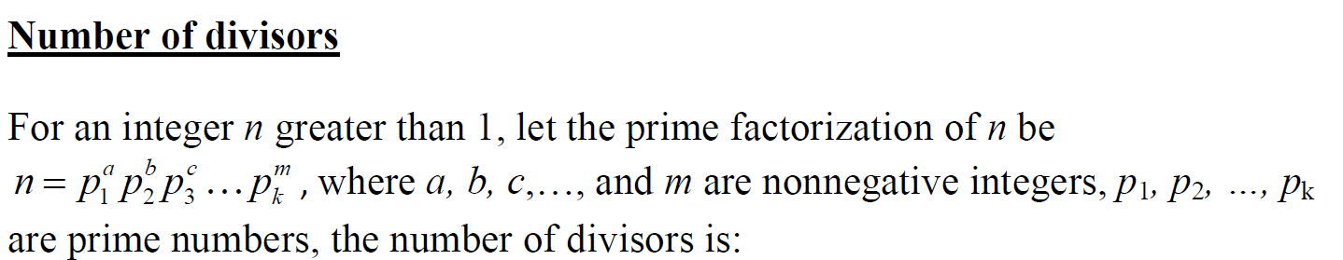
Lead in

Slide 5
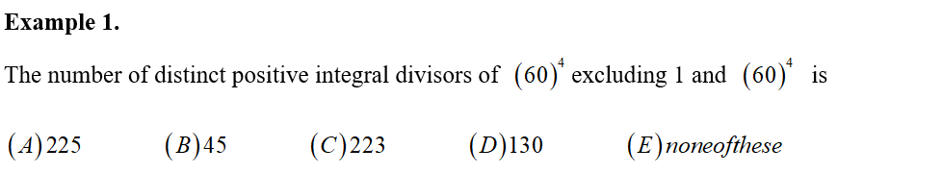
Example

Slide 6
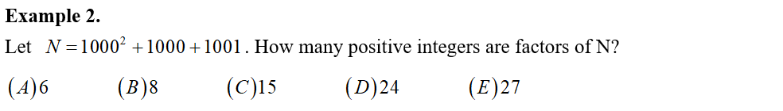
Example

Slide 7
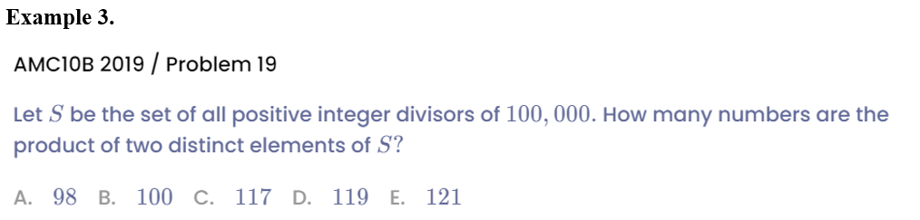
Example

Slide 8
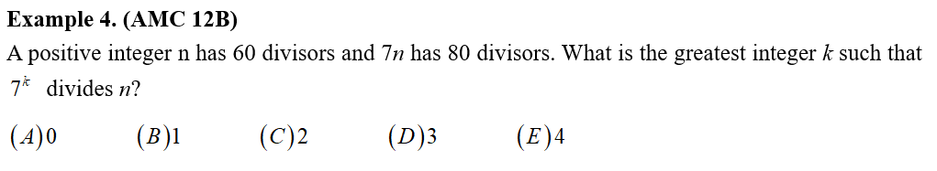
Example

Slide 9
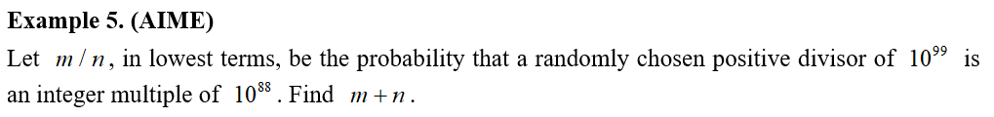
Example

Slide 10
Part 2
Number of Factors that are square/cubic numbers

Slide 11
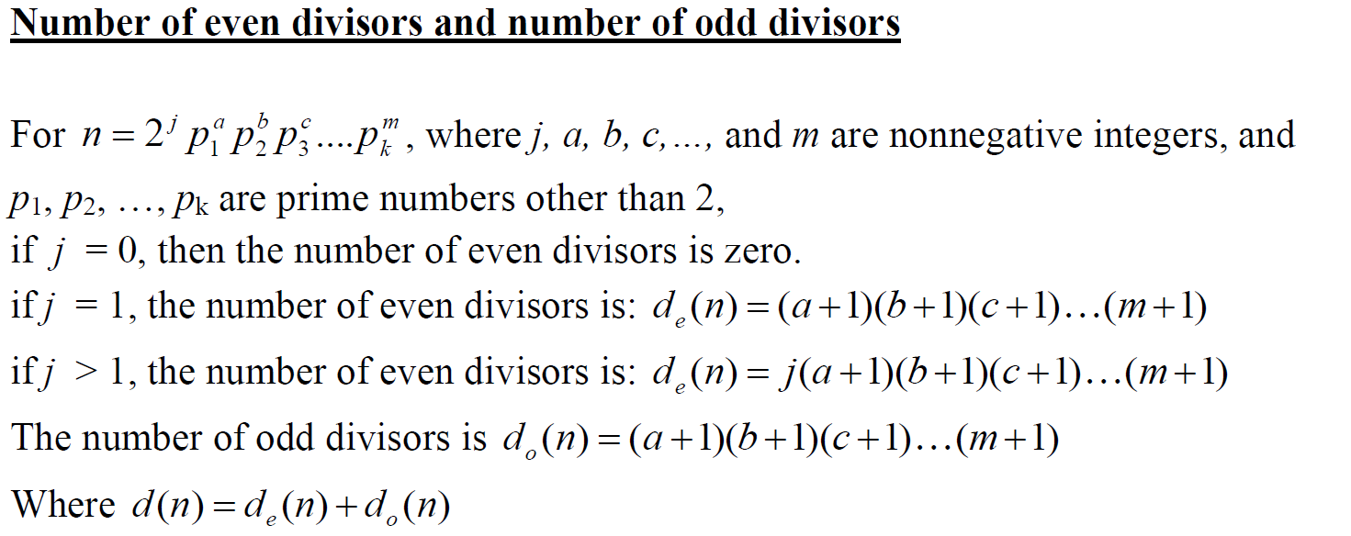
Lead in

Slide 12
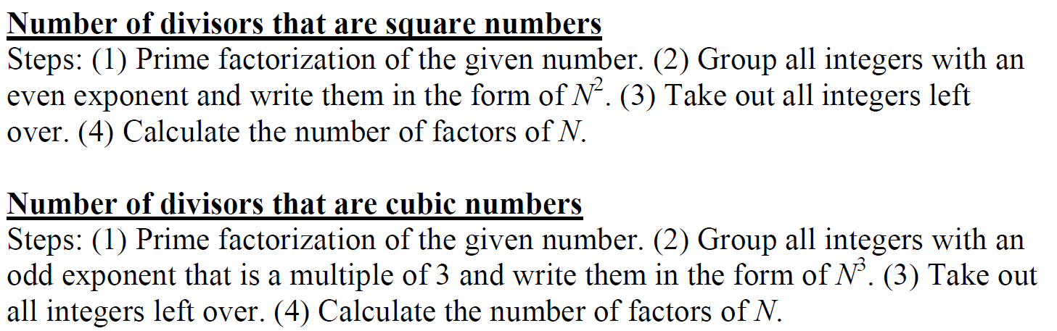
Lead in

Slide 13
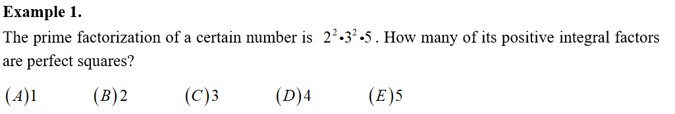
Example

Slide 14
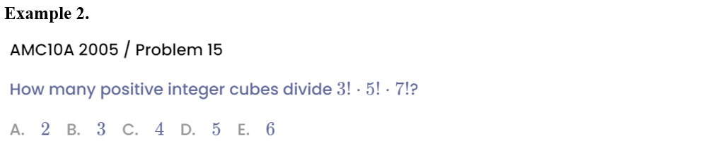
Example

Slide 15
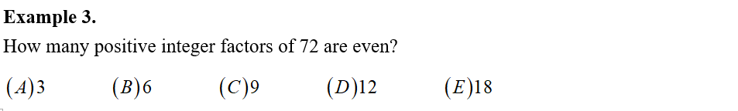
Example

Slide 16
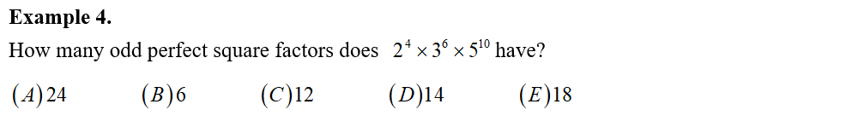
Example

Slide 17
Part 3
Inverse application

Slide 18
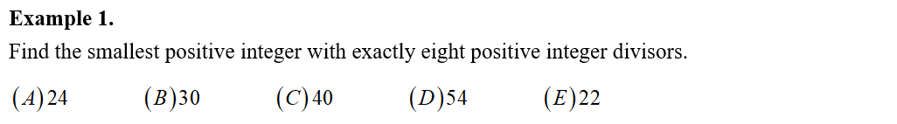
Example

Slide 19
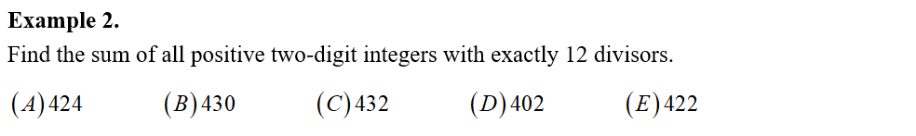
Example

Slide 20
Example

Slide 21
See You Next Time!

